Slide 1
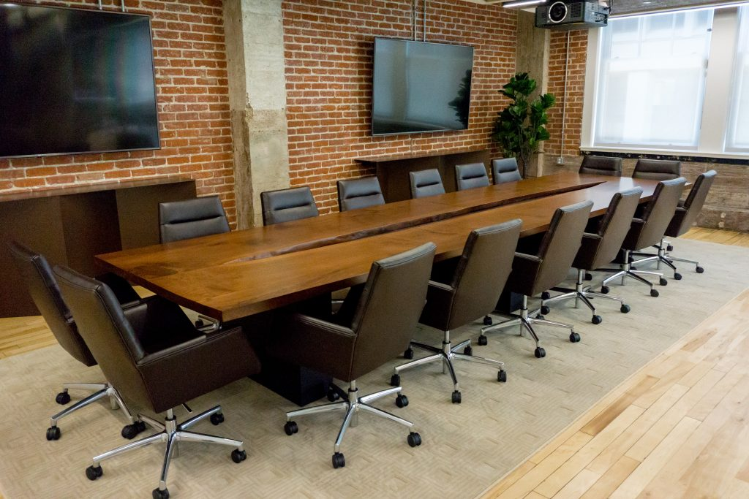
Managing & Developing Volunteer Boards
Monday, October 5th, 7:30 p.m.
Welcome!
Thank you for your engagement and time!
Please help other attendees by changing your zoom name to include your club or chapter.
Each registrant will be emailed the presentation following the event.
Special Guest: Jesse Wexler, Circle of Gold Member & Past President of the NYC Noles.

Slide 2
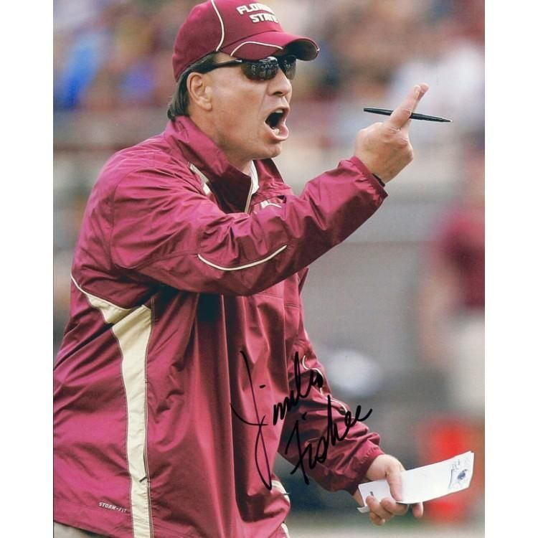
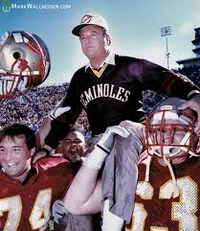
Better boards begin with…you!
Be aware and honest about yourself, your personality, strengths & weaknesses.
What is your motivation in serving locally?
What helps drive you?
What drives you nuts?
In what ways can you develop yourself to strengthen your board?
How will you approach your service? Will you take the Fisher approach or the Bowden philosophy?
Answering these questions honestly will go a long way in ensuring a successful club and building your Nole Network.

Slide 3
Before the first board meeting…or now!
Always be mindful that you are leading human beings, who just happen to be volunteering for Florida State and their community.
-Think of Mike Norvell walking in to the locker room last December.
-Nobody cares how much you know…until they know how much you care.
Be a good teammate/coach. Invest in your fellow board members.
Get to know them. Tell them your story, hear theirs, line up your “why’s”. Connect.
Many newer volunteers are looking to connect with a culture and family they consider “home”
Go past email. Go past a tag. Text or call for no board reason.
Say thank you. And mean it.
You’ll be amazed at what a little bit of effort can do for another board member, both personally and for your board.

Slide 4
Q: “How do I get people to work & be effective, especially when football is rough?”
A: Build trust, stability & be effective yourself.
Trust:
Carry your weight in the same way you ask & expect of others.
Don’t use only your friends and don’t abuse connections of other board members.
Stability:
Avoid the squirrels. Don’t jump around from goal to goal.
Set tangible goals that can be accomplished by your board.
Effective:
Communicate clearly, timely and regularly. Avoid the open air…
Be S.M.A.R.T.
(Specific, Measureable, Achievable, Realistic, Tangible.)

Slide 5
Q: “How do I get people to stick & stay?
Intentionally Develop Them
Speak to the purpose of serving a club…it isn’t just beer and football.
Ask people what their strengths are and let them go work, you’ll get more buy in.
Use social media to ask for specific needs!
Invest in people at events. Thank them, invite them back. If they find it to be fun, they are likely to be repeat guests…and you can build a relationship.
Be purpose filled at events, individually and as a board.
Give people ownership of events over areas. Cross training.
Follow up after events with thanks you’s and positives. Tell stories internally and externally.

Slide 6
Let’s Hear from one of the most successful Noles in this area.
Jesse Wexler
B.S. (‘06), International Affairs from Coral Springs.
Member of the Unconquered Spirit Society.
2019 Inductee, Circle of Gold.
Past-President, NYC Noles

